Slide 1

I European international
Software quality assurance conference
Maik Nogens
MaibornWolff GmbH, Hamburg, Germany
Testing VR – The Testing Trinity
Hardware, Software and You
Riga. March 22–23, 2019
sqadays.eu

Slide 2





Maik Nogens
Maik Nogens
@MaikNog
Quality Evangelist
+49 151 544 22 475
maik.nogens@maibornwolff.de
Tester & Consultant
Community servant
(QS-Barcamp, STUGHH, Meetup, ASQF, PotsLightning, GATE, …)
Inventor of the STWC
(Software Testing World Cup)
Designer of the Agile Unicorn

Slide 3






















Data and facts of MaibornWolff
400+
employees
30 Mio.
sales *
8 years in a row
Hamburg
Frank-
furt
Berlin
20 nationalities
München
Augsburg
1 week R&D
per year
SBB CFS FFS
Estimated for 2017

Slide 4
Shape IT for the people you work with
Test automation
agile
Consulting
DevOps
Test management
IT strategy
Web
engineering
Early phases
Human
centered
Mobile
Engineering
Test consulting
Implementation
Blockchain
Digital
trans-formation
Internet of
Things
Enterprise
Applications
Salesforce
Software audits
and reorganisation
Testing
IT-Consulting
Software development

Slide 5
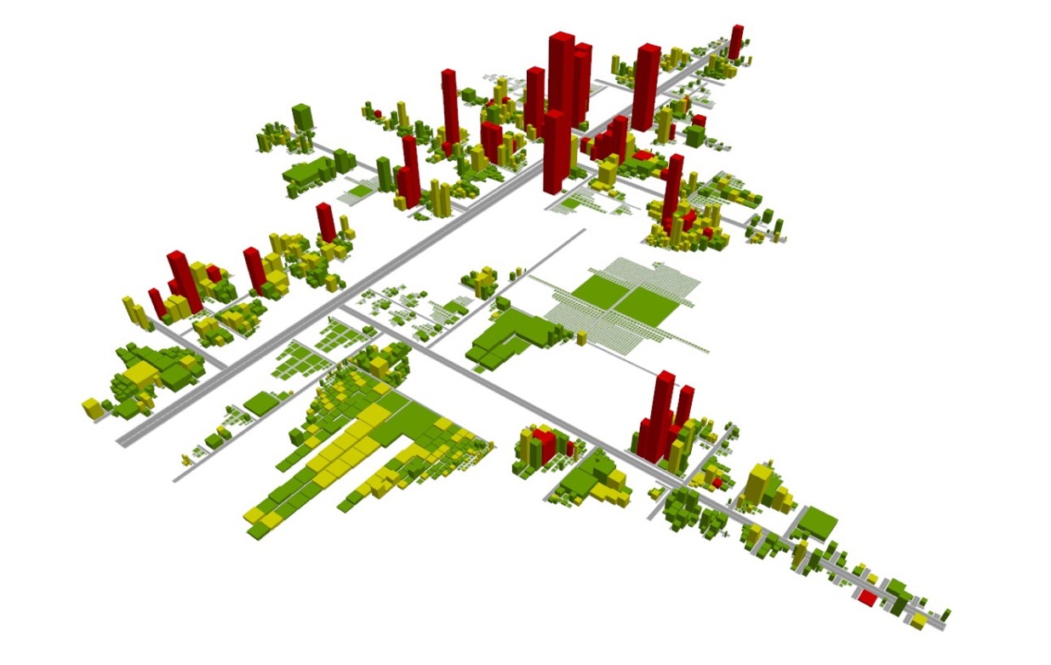
The human centric approach makes the difference
Design
Thinking
Personas
Big Pictures
Customer
Journeys
Prototyping
Serious
Games
Software-
Maps

Slide 6
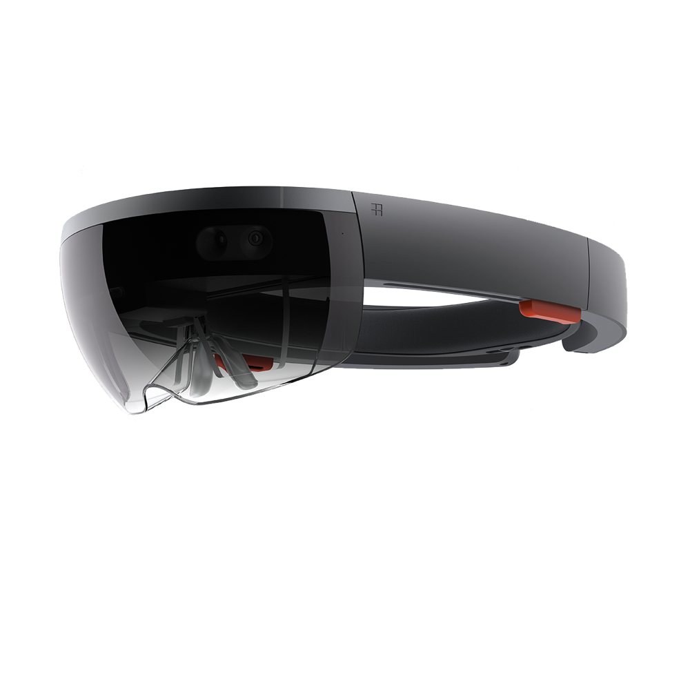
Agenda
Why should we prepare for VR and AR?
What is it anyway? Terms and Definition
Overview Hardware
Overview Software
Overview Human (Body & Mind)
Challenges (HW, SW, You)
Questions and discussion
Notes:
Question to audience:
Does someone has work experience with AR/VR?
Is someone already testing AR/VR

Slide 7
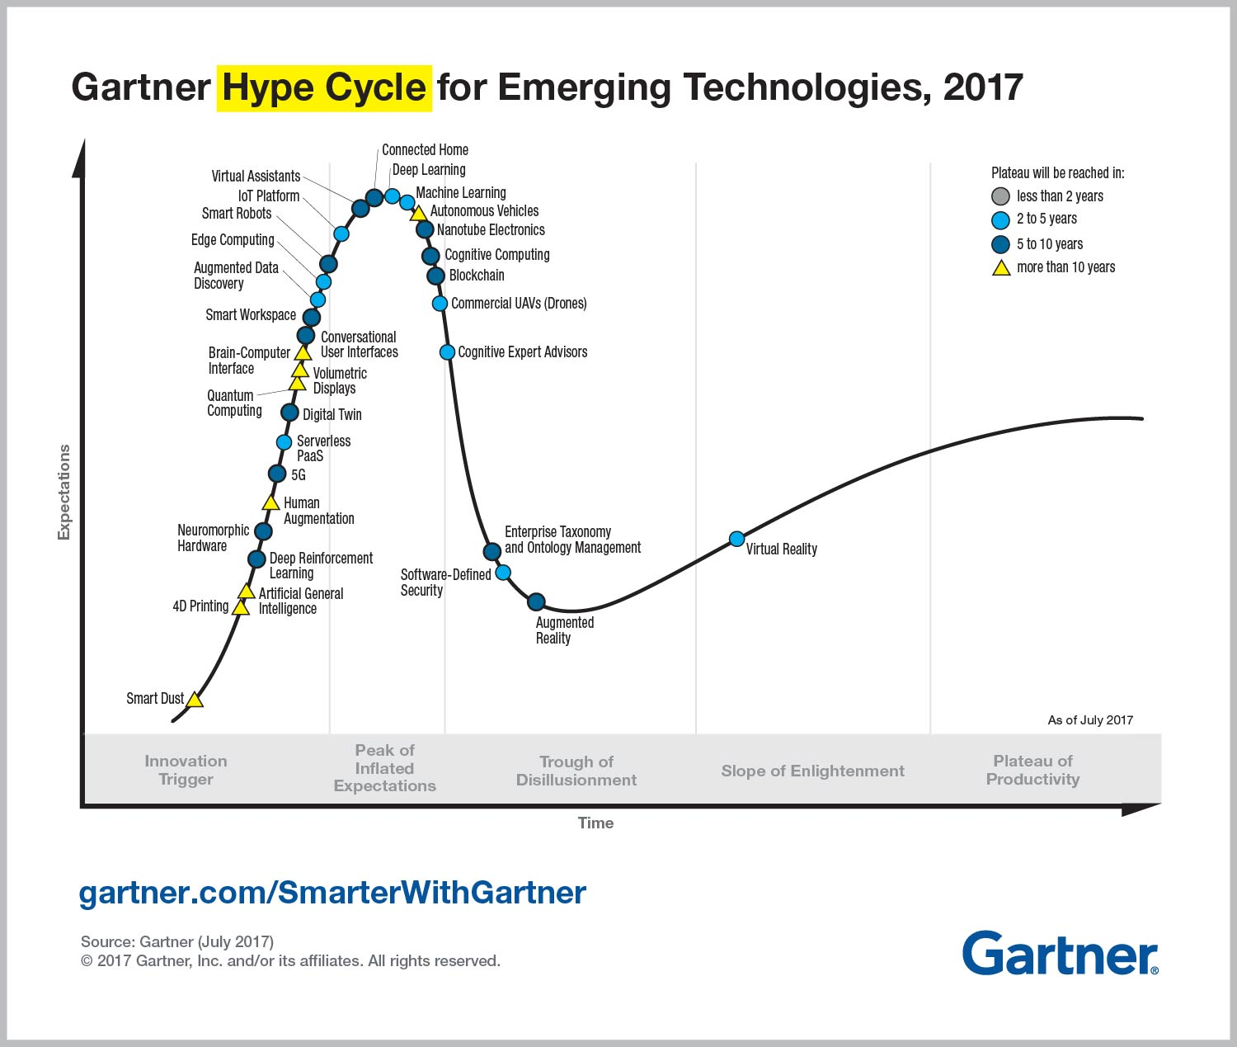
Notes:
Digital Twin:
The digital twin is meant to be an up-to-date and accurate copy of the physical object's properties and states, including shape, position, gesture, status and motion.^{[13]}
A digital twin also can be used for monitoring, diagnostics and prognostics to optimize asset performance and utilization. In this field, sensory data can be combined with historical data, human expertise and fleet and simulation learning to improve the outcome of prognostics.^{[14][15][16][17]} Therefore, complex prognostics and Intelligent Maintenance System platforms can leverage the use of digital twins in finding the root cause of issues and improve productivity.^{[18][19]}
Examples of industry applications:
Aircraft Engines^{[20][21]}
Wind Turbines^{[22][23]}
Large Structures e.g. offshore platforms, offshore vessels etc.^{[24]}
HVAC control systems^{[25]}
Locomotives^{[26]}
Buildings^{[27]}

Slide 8
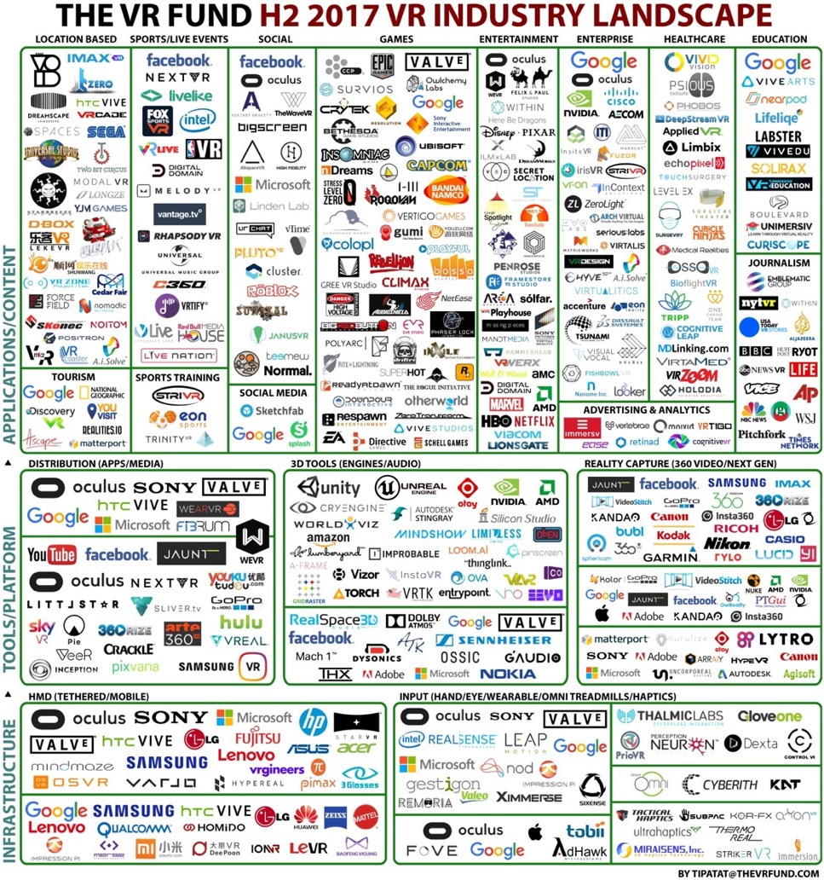
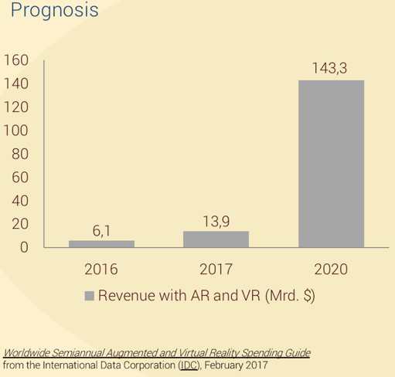
Notes:
You want go feel, when you grab stuff? ➔ It is already there: ➔ Haptic Gloves
You want to feel, when you get hugged or hit by a ball? ➔ It is already there ➔ Haptic Suits
You want to move your feet to travel around? ➔ It is already there ➔ Threadmills
You name it and most likely there is already a prototype existing..

Slide 9
Agenda
Why should we prepare for VR and AR?
What is it anyway? Terms and Definition
Overview Hardware
Overview Software
Overview Human (Body & Mind)
Challenges (HW, SW, You)
Questions and discussion

Slide 10
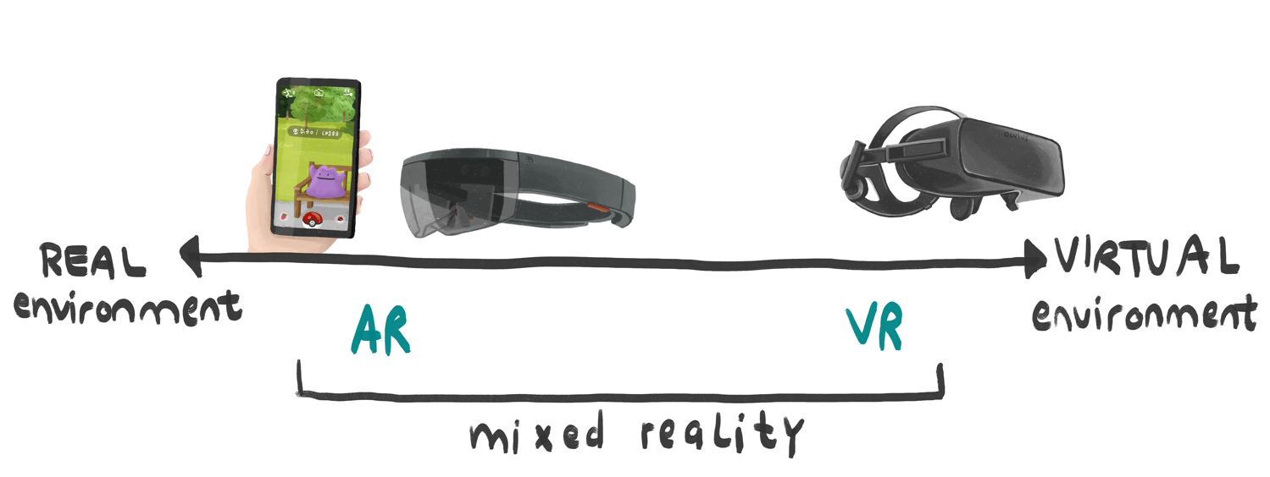
Terms & Definition: Spectrum of xR
Immersive headsets
(occluded)
Smartphone
based
Holographic headsets
(see-through)
Adapted from Milgram and Kishino’s RV-continuum (1994)
(merged reality)
Assistive:
Supports human tasks, e.g. mechanics with repair guide on a Hololens
Transformative:
Artificial experience, e.g. different planet, riding a dinosaur, change body size
AR: The extension of the visual perception through the situational-awareness display of computer-generated information on devices which are portable and in the field of view.
    VR: The display and experience of reality und its physical attributes in a real-time computer-generated, interactive virtual environment.
Notes:
Not to be mistaken for Microsofts „Mixed Reality“.. This is just a brand/product name.
(Not helpful from MS, btw!)
Merged Reality:
http://www.wired.co.uk/article/intel-project-alloy-headset-vr-merged
http://www.appliedart.com/blog/vr-ar-or-mr-what-s-the-difference-why-should-i-care
Milgram and Kishino’s (1994: Augmented Reality: A class of displays on the reality-virtuality continuum
https://www.google.com/url?sa=t&rct=j&q=&esrc=s&source=web&cd=1&cad=rja&uact=8&ved=2ahUKEwjntJTJxZ7eAhUyM-wKHRiYCZ8QFjAAegQIBxAC&url=http%3A%2F%2Fetclab.mie.utoronto.ca%2Fpublication%2F1994%2FMilgram_Takemura_SPIE1994.pdf&usg=AOvVaw1LUKUrYBYJwDlFMMBNr8SS

Slide 11
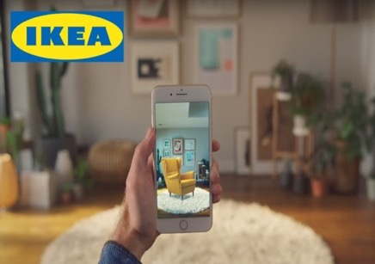
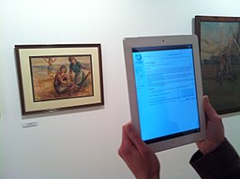
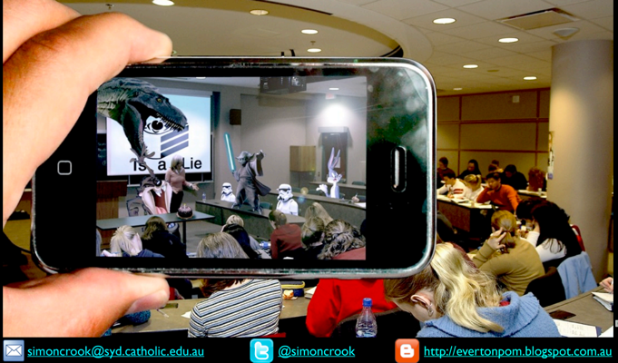
Terms & Definition: AR
Assistive
Assistive
Transformative
Notes:
14:40 in masterclass video
https://commons.wikimedia.org/wiki/File:Augmented_reality_at_Museu_de_Matar%C3%B3_linking_to_Catalan_Wikipedia_(49).JPG

Slide 12
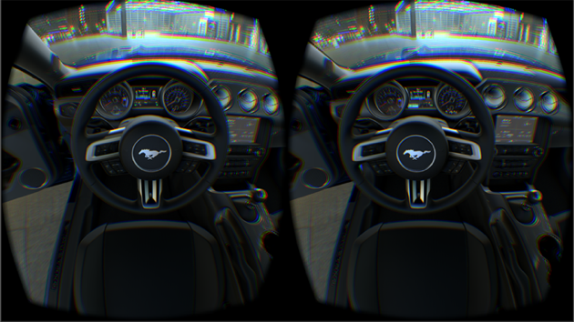
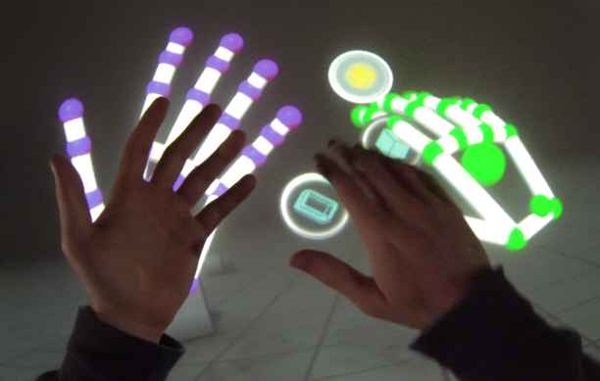
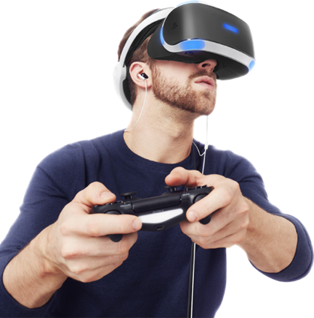
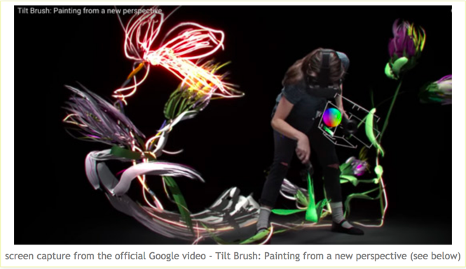
Terms & Definition: VR
Assistive
Transformative
Notes:
https://makingamark.blogspot.ro/2016/05/google-tilt-brush-for-painting-in-3d.html

Slide 13
Agenda
Why should we prepare for VR and AR?
What is it anyway? Terms and Definition
Overview Hardware
Overview Software
Overview Human (Body & Mind)
Challenges (HW, SW, You)
Questions and discussion

Slide 14
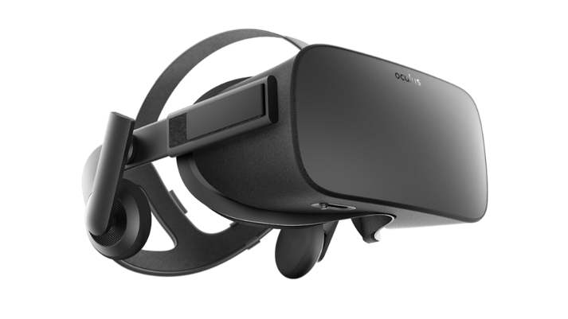
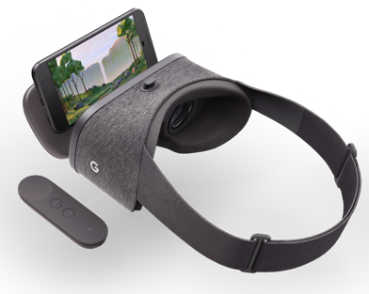
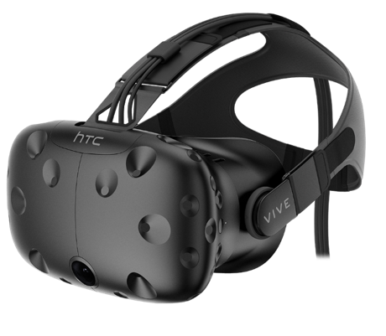
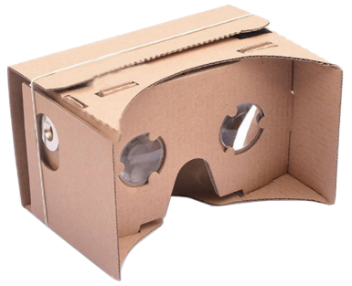
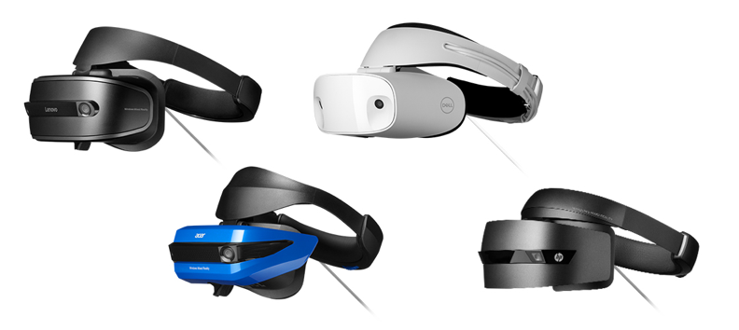
Overview Hardware
Smartphone based
VR
Independent
Notes:
Independent: Works in and with it self, aka processor, storage, etc. are all in the device
Smartphone based: The app uses a regular smartphones inventory

Slide 15
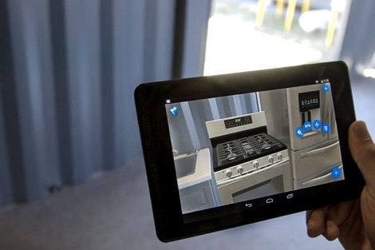
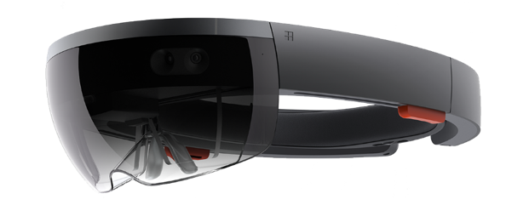
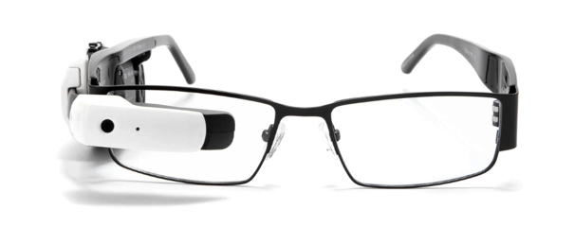
Overview Hardware
Smartphone based
AR
Independent

Slide 16
Agenda
What is it anyways? Terms and Definition
Overview Hardware
Overview Software
Overview Human (Body & Mind)
Challenges (HW, SW, You)
Questions and discussion

Slide 17
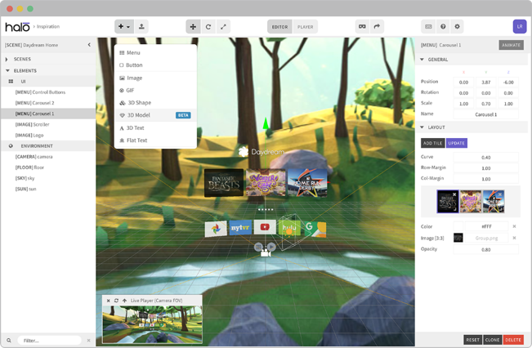

Overview Software
For fast and native VR/AR applications, e.g. on a smartphone
  Prototyping Tools
  Native Development
Google ARCore
Vuforia
  Halo Labs
  Sketch-to-VR
ARKit
Notes:
ARCore = Google = Android
ARKit = Apple = IOS

Slide 18
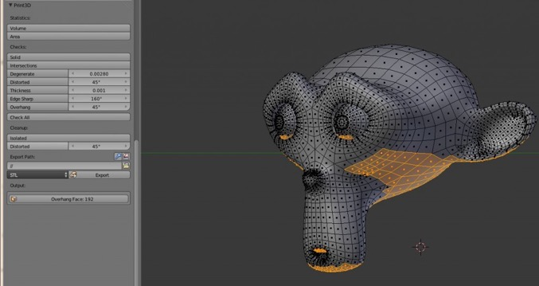
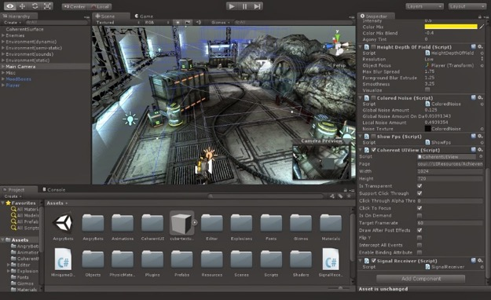





Overview Software
For complex VR/AR applications, especially for independent glasses
  Development engines
  3D-Modeler
Cinema 4d
90%
10%
Estimated usage

Slide 19
Agenda
What is it anyway? Terms and Definition
Overview Hardware
Overview Software
Overview Human (Body & Mind)
Challenges (HW, SW, You)
Questions and discussion

Slide 20
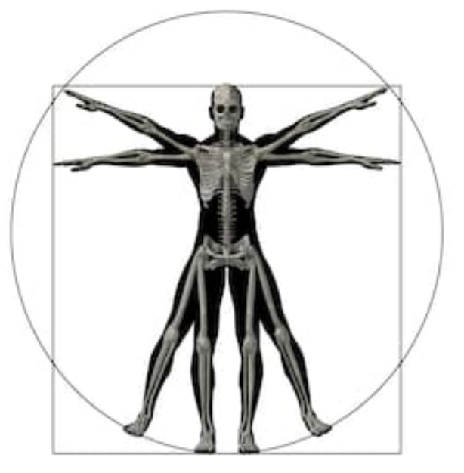
Overview Human (Body & Mind)
Body
Height (➔ VR objects vs. person in VR)
Skin (➔rashes)
Hair (➔ straps vs. movement)
Eyes (➔ glasses, focus)
Hearing (➔ deaf, tinnitus)
Hands (➔ Left, Right, None)
Weight (of hardware) (➔ bulkiness)
Sense of Balance (~ Motion sickness)
Shutterstock.com
Notes:
Height => VR objects need to be „real“ size (e.g. Oculus setup has „how tall are you? Difficult with multi-user; person profile switch like Netflix?
Skin; Sweatiness => foggy glasses, unhygienic, public usage ➔ change foam visor spare part
Skin; rashes, allergies
Hair => Can the device be used with A LOT of hair? Or without hair (does it slip on head movements)?
Ears; glasses => Can the device be used with glasses?
Hearing => for positional audio.. What if user has no hearing at all or on one ear?
Left/right handed => HoloLens has the „standard“ right hand gesture menu to open and interact
Weight => headsets can be heavy and uncomfortable. Wireless set top boxes (TPCast) can add additional weight.

Slide 21
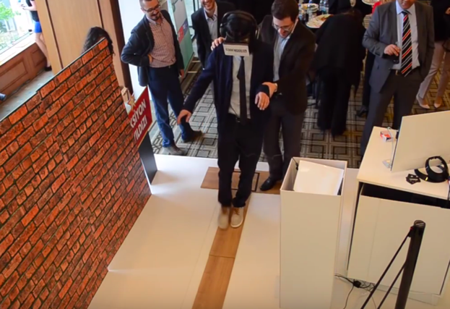
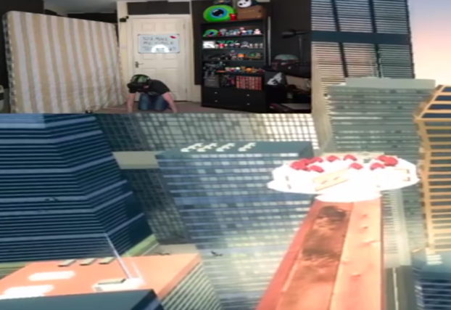
Overview Human (Body & Mind)
Mind
Hormones (➔ Phantom limb relief)
Distraction (➔MRI)
Fears (➔ Plank over abyss; Spiders)
Memories (➔ Swimming with Dolphins)
Emotions (➔ Impulse Shopping)
https://www.youtube.com/watch?v=P60rb48oDWM
https://www.youtube.com/watch?v=kGSMypiRsd8
Notes:
Hormones; phantom limb relief
Distraction; Child in MRI
Plank over abyss VS standing on solid ground
Memories; study with young children VS. re-study when they were 5 years older (swimming with Dolphins)
Emotional closeness, e.g. impulse shopping => distance with monitor gives time to reflect; missing in VR
https://www.youtube.com/watch?v=P60rb48oDWM

Slide 22
Agenda
What is it anyway? Terms and Definition
Overview Hardware
Overview Software
Overview Human (Body & Mind)
Challenges (HW, SW, You)
Questions and discussion

Slide 23
Testing Challenges - Hardware
Re-use knowledge from “Mobile Devices”, e.g.
  Device fragmentation
  Battery consumption
  Bandwidth consumption
  Heat (especially for HMD)
  …
xR specific:
  Tracker hardware (e.g. HTV Vice uses Infrared)
  Wearing comfort; bulkiness
  …
  New hardware concepts might bring new challenges (e.g. Teslasuit, haptic gloves, etc.)
Tip: Daniel Knotts blog and book: http://adventuresinqa.com/hands-on-mobile-app-testing
Notes:
Infrared:
Watch out for mirroring surfaces, e.g. glass.
Vive headset can see the reflection of infrared as a separate tracking station and that can mess up the correctness of the tracking and positioning

Slide 24
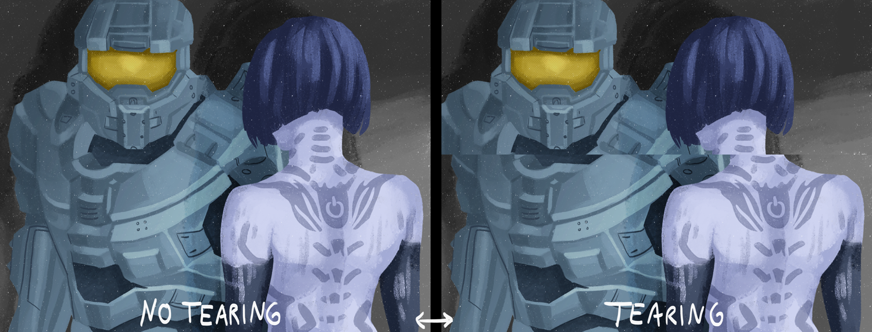
Testing Challenges - Software
Re-use “general testing” knowledge, e.g.
  Security
  Performance (e.g. memory usage)
  Usability (e.g. natural gestures, movement)
Framerate (min. 90 FPS)
  FPS is actually less important than the lower response time.
  The HMD needs to track your movement quickly, so that what you see isn’t disconnected from the acceleration you sense, and higher framerates help with that.
  30 FPS has ~33ms between frames, while 90 FPS has only ~11ms.
Mnemonic:
“The Hard Shake”
by Syed Ali (@simTesting)
Notes:
Security: http://www.wired.co.uk/article/oculus-rift-drm-hacked. ; https://www.hackread.com/how-to-hack-facebook-account-with-oculus-integration/
Framerate: min. 90 (https://help.irisvr.com/hc/en-us/articles/215884547-The-Importance-of-Frame-Rates)

Slide 25
Testing Challenges - Human
Motion sickness
Emotions
Physical attributes
Height dimensions inside VR
Immersion is key
Harder to separate the “observer” from the “subject” point of view (science).
Confirmation bias
Resilience to motion sickness (can u de-sensibilize? No studies)

Slide 26
Motion sickness
Ears
Eyes
Sense of balance: „I am not moving “
„I am moving “
Notes:
Discrepancy between seeing motion, but not feeling it.
Skin gravity pressure (acceleration)
Inner ear vs. Visual system

Slide 27
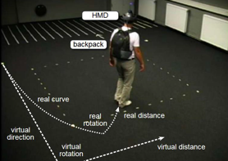
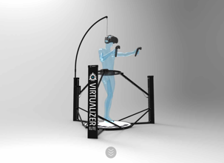
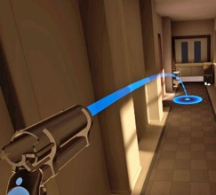
Motion – xR variants
Real walking
Needs space
Redirected Walking
Needs space (estimated 20m radius)
Arm swinger
CAOTS
Feels un-natural
Exhausting
(~head bob & arm motion)
Omni-directional treadmill
Market availability?
Teleportation
No continuous motion
Notes:
CAOTS = Controller Assisted On the Spot locomotion
https://www.kitguru.net/components/vr/jon-martindale/vr-locomotion-solved-the-caots-system/
https://hugerobotvr.com/projects/#freedom-locomotion-vr

Slide 28
Conclusion for VR Testing
VR has more „Human (B&M)” issues than AR
Immersion is the key factor for the success of an VR experience
Harassment in virtual space (~safety gestures)
Data collection (biometrics)
Acceptance by society (~ Google Glasses)
Automation above code level is still not mature
Exploratory Testing, combined with Pairing can provide good results
Notes:
Exploratory Testing, combined with Pairing can provide good results; one in VR, one watching on monitor; different point of views

Slide 29
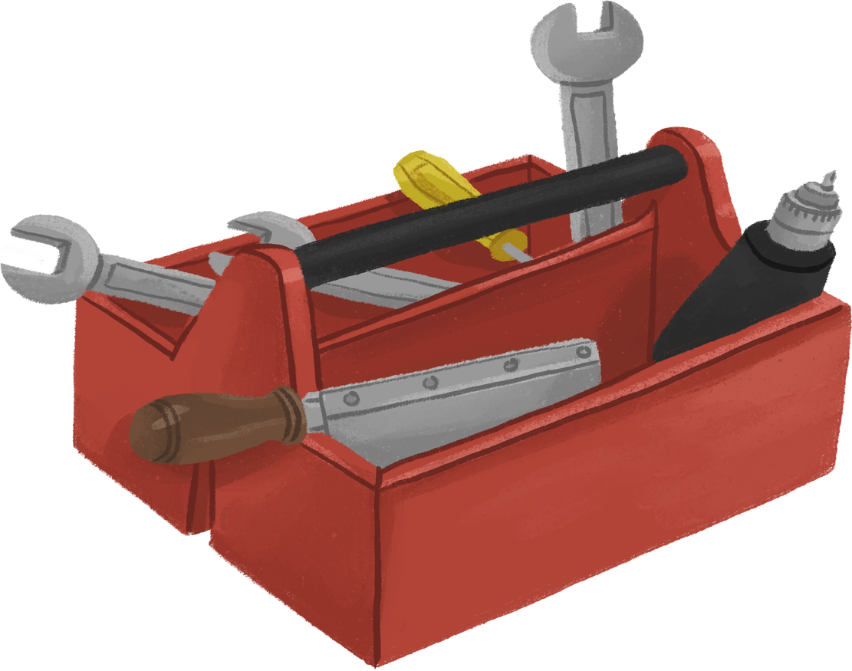
Bonus - Useful tools and tips

Slide 30
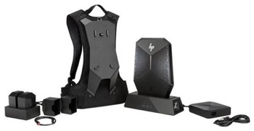
Testing Setup
Get a dedicated room
VR HMD is cable tethered to computer (ca. 4m)
Option: Get a powerful laptop and a bag
Plan the physical setup of the sensors and the computer
Plan for avoidance of collision with random people walking through the space, aka secure the entrance.
Physical safety: Advise users of VR about the cable and boundaries
Adjust the HMD accordingly, so the wearing is comfortable and also, that no outside light comes between the mask and face.
Notes:
3300 Euro Backpack with PC :: https://www.computeruniverse.net/de/hp-z-vr-backpack-g1-2zb91ea-mini-pc-mit-windows-10-pro?acode=vorteil319&agt=10806&utm_channel=psm&utm_source=google-pla&utm_campaign=cpo&utm_medium=artikel&utm_content=90726826
Display link; tpcast , …
The sensor cables are 2.5m (8'), and the Rift cable is 4m (13'). ... Is there a maximum length I should look out for before effecting the connection ...

Slide 31
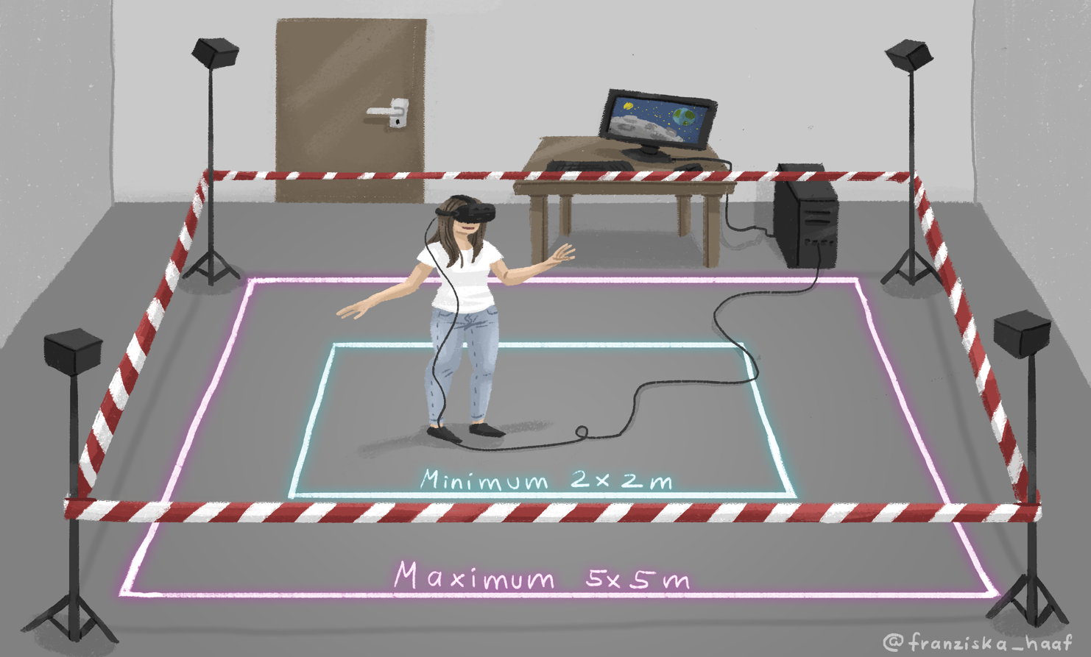
Testing Setup
Artist:Franziska Haaf (https://twitter.com/franziska_haaf)
Notes:
Artist: Francisca Haaf
For room scale VR you will need a minimum of 2 meters by 1.5 meters of free space (6.5ft x 5ft), and the maximum distance between base stations is 5 meters (16ft).
Note: For the best experience, your base stations should be above head height, stable, pointed down 30-45 degrees, and have an unobstructed view of each other.

Slide 32
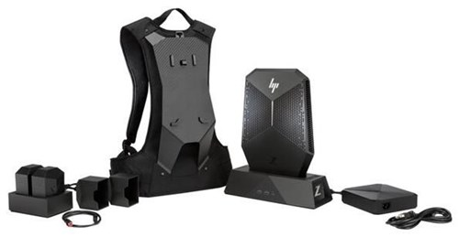
Testing Setup
3300,- €
Backpack with PC
Source: https://www.computeruniverse.net/de/hp-z-vr-backpack-g1-2zb91ea-mini-pc-mit-windows-10-pro?acode=vorteil319&agt=10806

Slide 33
Testing Tools
OVR Metrics Tool
Oculus Tray Tools
Oculus Remote Monitor
Unreal Profiler Tool
Console (e.g. via logcat and VrAPI )
VRTK (collection of useful scripts)
Additional Third-Party Tools (depending on HW chips or similar)
  FCAT (created by NVIDIA to analyze GPU performance)
  Afterburner (video capture, temperature, usage, voltage, clock speed)

Slide 34
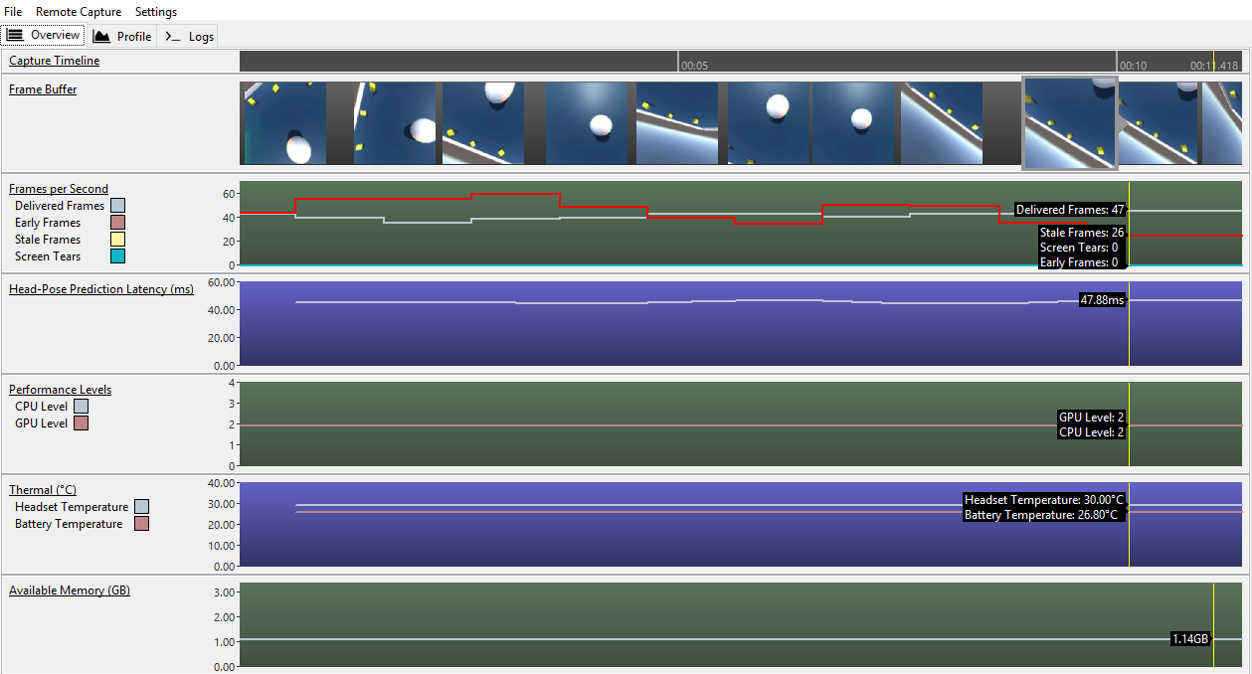
Testing Tools
Source: https://developer.oculus.com/documentation/unreal/latest/concepts/unreal-debug-gearvr/

Slide 35
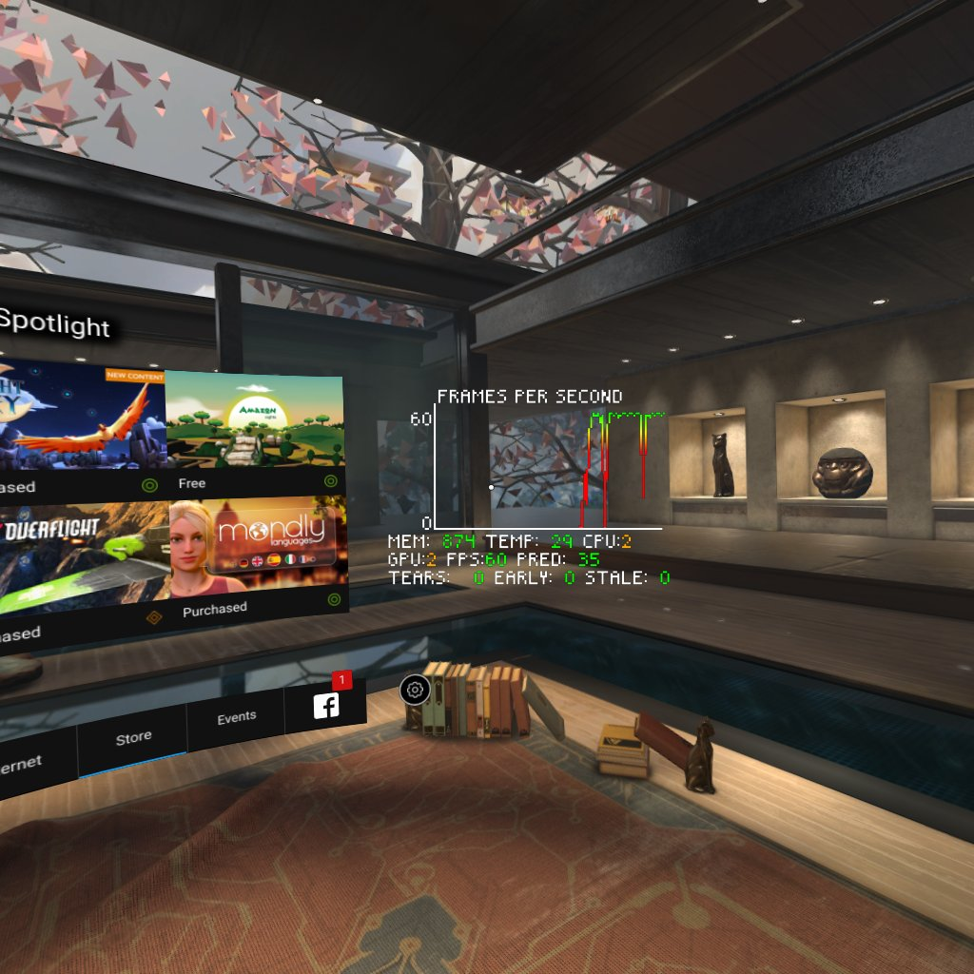
Testing Tools
Source:https://developer.oculus.com/documentation/unreal/latest/concepts/unreal-debug-gearvr/

Slide 36
Performance Testing
Performance Targets
Establish clear targets to use as a baseline for calibrating your performance.
These targets can give you a sense of where to aim, and what to look at if you’re not making frame rate or are having performance problems.
Below you will find some general guidelines for establishing your baselines, given as approximate ranges unless otherwise noted.
Display Refresh Rate
60 FPS (minimum required by Oculus Store), or 72 FPS if your application can support this display refresh rate
50-100 draw calls per frame
50,000-100,000 triangles or vertices per frame

Slide 37
Link Collection
Oculus
https://developer.oculus.com/documentation/unreal/latest/concepts/unreal-debug-go/
https://developer.oculus.com/documentation/unreal/latest/concepts/unreal-general-topics/
VRTK
https://github.com/thestonefox/VRTK
https://vrtoolkit.readme.io/docs/getting-started
Geforce
Downloads: https://www.geforce.com/hardware/technology/fcat/downloads
Direct Download FCAT VR: https://international.download.nvidia.com/geforce-com/international/downloads/FCAT-VR_v3.26.0.zip
https://www.geforce.com/whats-new/guides/fcat-vr-download-and-how-to-guide
MSI Afterburner
https://de.msi.com/page/afterburner
Reading
https://www.reddit.com/r/oculus/comments/9jytbg/rift_performance_monitoringlog_not_osd/
https://www.reddit.com/r/oculus/comments/8g9mii/best_way_to_monitor_performance/
https://www.reddit.com/r/skyrimvr/comments/8bs5ry/psa_use_steamvrs_builtin_frame_timing_monitor/
https://www.reddit.com/r/Vive/comments/4qkjui/what_is_reprojection/
Notes:
(German) https://vrodo.de/oculus-rift-dieses-tool-ist-ein-muss-fuer-jeden-rift-nutzer/

Slide 38

Thank you!
I European international
Software quality assurance conference
Questions and discussions
Riga. March 22–23, 2019
sqadays.eu

Slide 39
Software Testing
Tearing
FPS drop
Color scheme
Pixelation
360 tracking
Reprojection (used to always achieve 90 FPS)

Slide 40
SteamVR : had built in performance metrics as well. Once enabled through SteamVR setting, just turn your right hand upside down. I prefer using Tray Tool's overlay though. Much quicker. Why aren't you using Dash? You don't have to take your headset off to access your desktop.
Oh cool, is there a list of voice commands available? level 3CaptnSlow
Rift1 point · 10 months ago
You can customize them to anything you want. Click the Edit button next to Voice Commands. Personally i prefer to just use Dash to make my changes.
I think Oculus Tray Tool also has keyboard shortcuts assigned to the display overlay but i dont think those keyboard shortcuts can be edited.
The tray tool is also useful for setting super sampling if you have some headroom left over to further raise graphics quality. I tend to also use MSI Afterburner in Dash showing graphs of CPU and GPU usage for further fine tuning of settings but the performance monitor in Oculus Tray Tool is more convenient and quick.
(Windows 10 also lets you view CPU and GPU usage in the Performance tab but when viewing CPU usage it is important to view per core usage since the overall CPU usage can fool you by not showing if a single core is being a bottleneck)
OpenVR’s tools as a reference for monitoring
SteamVR settings > Video > Frame Timing > Show In Headset.
Reprojection einstellungen sollen Spielen/Software dabei helfen immer 90fps zu erreichen, ich habe die ersten beiden immer an und die dritte aus. Was du jetzt an und auschalten solltest kommt ganz auf die Einstellungen der Spiele, die Art des Spiels und dein System an verwirrt..
To summarise without getting technical it'll lock your VR frame rate to 45 whenever your system can't maintain 90. The trade off is that whilst it's pretty juddery, it's consistency is better and less nausea inducing than letting the frame rate fluctuate all over the place, and it also helps approximate head tracking movement when the system might otherwise not have time to display your movement. It's still a crutch though. Meant to stop you having a terrible experience when your system can't keep up. Playing at 45fps is not fun at all. Supersampling has made it more of an issue as it increases the workload on your system and increases the frequency reprojection is used. When you see someone saying they have it set to 2.5 on a 980 and it's "buttery smooth", they're using reprojection almost constantly and somehow they don't mind or notice the difference. Most people do notice and it's horrid. This means you now have to find the sweet spot where SS makes a difference to you visually without leaving SteamVR having to use reprojection constantly. And not everyone seems to get that. You still want it turned on for general use. It'll only kick in when needed. But turning it off and turning the frame time monitor on in your HMD can help identify if you're actually running at 90fps or dropping frames that reprojection would otherwise be masking. level 2maxiimus1
1 point · 2 years ago
It doesn't just lock it to 45 tho. It kinda fakes 90 fps, guessing every second frame. So you still get 90 fps, just half of those are not "real" frames. Saying it only locks to 90 fps is very misleading.
You always leave it on. It'll only use it if it needs to. Generally speaking that wouldn't ever happen on your setup. Exceptions being non native VR stuff. Think Project Cars or Elite where you're able to put the settings too high. Super sampling has changed the landscape a little here though since the user can now change the workload by setting SS too high. Thus SteamVR uses reprojection when it can't keep a solid 90fps. This is what's happening to all the idiots claiming they can play games at 3.0 SS. They can't without reprojection. It looks like trash.
Performance, HW monitor
Notes:
Reprojection einstellungen sollen Spielen/Software dabei helfen immer 90fps zu erreichen,

Slide 41
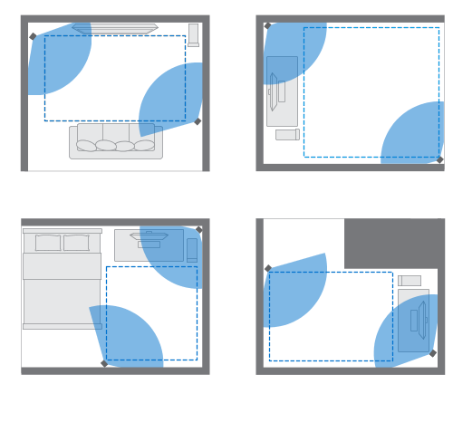
Physical Testing Setup
What are the space requirements?
For room scale VR you will need a minimum of 2 meters by 1.5 meters of free space (6.5ft x 5ft), and the maximum distance between base stations is 5 meters (16ft).
Note: For the best experience, your base stations should be above head height, stable, pointed down 30-45 degrees, and have an unobstructed view of each other.
Source: https://support.steampowered.com/kb_article.php?ref=7770-WRUP-5951
https://roadtovrlive-5ea0.kxcdn.com/wp-content/uploads/2016/12/vive-and-oculus-roomscale-comparison-2-1021x580.jpg

Slide 42
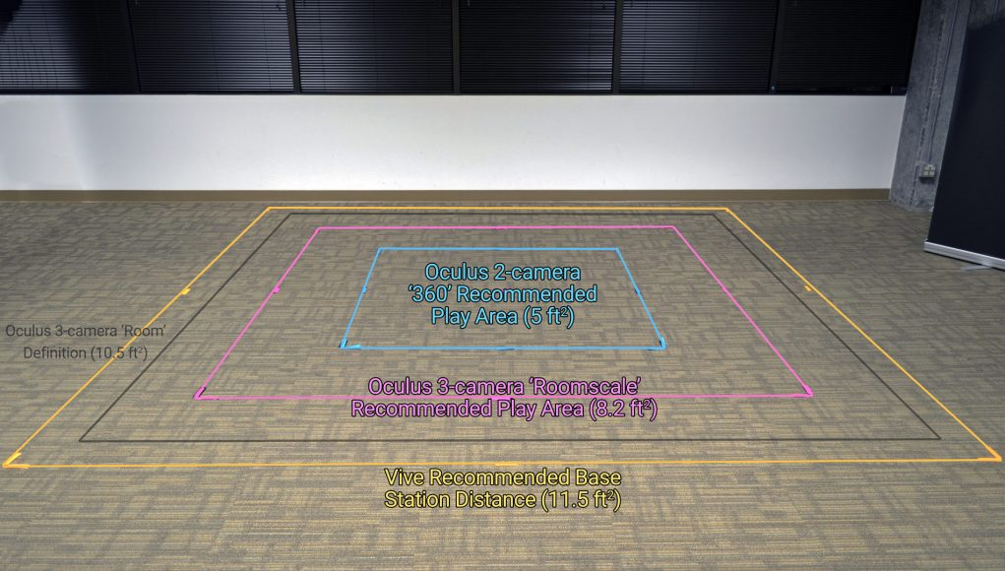
Testing Setup
All of the data here comes from official documentation. The HTC Vive setup guide recommends base stations are placed up to 16.3 ft diagonally, which makes a square play area that’s 11.5 ft on each side. You can see it in above in yellow.
In the 3-camera roomscale setup guide, Oculus defined a ‘room’ as being 10.5 ft on all sides (14.6 ft diagonally), which you can see above in grey. The actual play area within that room is 8.2 ft on all sides and 11.6 ft diagonally, above in pink.
For the 2-camera 360 standing setup, with two cameras placed in opposite corners just beyond the play area, the play area is 5 ft on each side and 7 ft diagonally, above in blue.
Notes:
https://www.roadtovr.com/oculus-touch-and-htc-vive-roomscale-dimensions-compared-versus-vs-visualized/

